Slide 1
SQL Server v.Next
Presenter
Travis Wright
Principal Program Manager
Notes:
Lets talk about SQL Server v.Next, the next major release of SQL Server, currently in public preview, which brings the power and innovation of SQL Server, for any application, to the platform of your choice.

Slide 2
SQL Server on Linux Agenda
Why SQL Server on Linux?
Scope
Architecture
Demos
Schedule
How to get involved

Slide 3
Businesses are embracing choice
Heterogenous environments
Multiple data types
Different development languages
On-premises, cloud, and hybrid environments
101001010010
{ }
T-SQL
Java
C/C++
C#/VB.NET
PHP
Node.js
Python
Ruby
Notes:
The business landscape is becoming increasingly diverse
Development and deployment environments include Windows, Linux, macOS, and Docker
Data is no longer relational, with companies accessing diverse data, including video, streaming, documents, relational, both external data and data internal to their org
Languages and frameworks are also expanding with the poularity of Node.js, Python, Ruby and others
Companies deploy on-premises, in the cloud, or both, with a hybrid solution

Slide 4
Microsoft is delivering on choice
NEW
SQL Server on Linux
HDInsight on Linux
R Server on Linux
Linux in Azure
SQL Server drivers and connectivity
Visual Studio Code extension for SQL Server
Python, Ruby, …
Notes:
Microsoft has delivered a number of products enabling choice for customers, including:
HD Insight on Linux - a managed Apache Hadoop, Spark, R, HBase, and Storm cloud service made easy
R Server on Linux - Use R—the powerful, statistical programming language—in an enterprise-class, big data analytics platform. Microsoft R Server is your flexible choice for analyzing data at scale, building intelligent apps, and discovering valuable insights across your business (https://www.microsoft.com/en-us/cloud-platform/r-server)
Linux in Azure – run Linux-based virtual machines in Microsoft Azure (IaaS)
Customers can take advantage of Microsoft–created database connectivity drivers and open-source drivers that enable developers to build any application using the platforms and tools of their choice, including Python, Ruby, and Node.js

Slide 5
The power of SQL Server
Everything built-in
Industry leader in
Mission Critical OLTP
Most secure database
Highest performing data warehouse
Best TCO
Most consistent experience
Best price/performance
7 years in a row least vulnerable
#1 performance
TPC-H
1/12th the cost of Oracle
On-premises to cloud
SQL Server
1/12
SQL Server
#1
SQL Server
#2
#3
Oracle is #5
TPC-E
Everything built-in
SQL Server
Oracle
MySQL2
SAP HANA
SQL Server 2016
June 2016
National Institute of Standards and Technology Comprehensive Vulnerability Database update 12/2016.
Notes:
SQL Server is the new industry leader and SQL Server 2016 is packed with value for customers and as with our history, that value is built-in to a single enterprise sku with no additional add-ons.
Let’s take a look at the top 5 reasons why you want to bet your business needs on SQL Server. If you are on SQL Server 2005 there is no better time to modernize your apps. If you are on Oracle or IBM, no better time to look again at the value you can gain today at a much lower TCO.
<click>
Industry leader in mission critical OLTP
In case you missed, there is a new leader in Gartner’s core database MQ, where SQL Server for the first time has de-throned Oracle in both execution and vision! Microsoft SQL Server has been the industry leader for two years in a row! Customers are realizing the value that Microsoft is delivering at a rapid pace and in a customer friendly way by building-in innovation verses requiring add-ons.
SQL Server also has #1 rankings across a number of TPC-E and TPC-H performance benchmarks
Speaking of security and performance, let’s take a look at how we fair against the competition.<click>
Most secure database
SQL Server continues to be the least vulnerable database 6 years in a row. NIST (National Institute of Standards and Technology) tracks database vulnerabilities and shows SQL as the lowest even though we have more units deployed in production than both Oracle and IBM combined. So what does that mean, if you look at the chart you will see Oracle has many more vulnerabilities, this doesn’t mean that Oracle didn’t address them, but until the vulnerability patch is released and you implement it your data is at risk. Fewer vulnerabilities means fewer patches and your data is less exposed to attack.
In addition, SQL Server 2016 delivers layers of protection with capabilities that can protect your data at rest and in motion, even in the memory buffer pool, without impacting database performance, along with the ability to control access and monitor threats. This multi-layered approach combined with proven track record of being least vulnerable provide you with the most secure database on the planet. <click>
Highest performing data warehouse
From a performance perspective, looking at TPC-H a standard benchmark particularly for Data Warehousing workloads, SQL holds the number #1, #2, and #3 spots for non-clustered scale up performance on multiple hardware platforms including HP, Lenovo and Cisco and for multiple data sizes including 1TB, 3TB and 10TB. Oracle comes in at #4. This not only showcases SQL Server performance, but performance at scale for data warehousing.
SQL Server 2016 can scale from data marts to the biggest DW workloads. With SQL Server 2016 enterprise you also get the rights to deploy our scale out MPP (massive parallel processing) data warehousing appliance, so again incredible value out of a single sku. <click>
End to end mobile BI on any device
Now let’s take a look at end to end mobile BI solution. Many of you may have heard about the Datazen acquisition we made to provide our customer with mobile BI on any device. Well in SQL Server 2016 this will be integrated into Reporting Services, which we are enhancing in a big way. What this means is you can now publish modern reports using PowerBI or Excel 2016 to an iPhone, Android phone, as well as Windows phone. Best of all its built-in so no need to buy a separate product. With the new integration of Power BI and SQL Server you can enable self-service BI in addition to mobility. Even if you choose to enable self-service BI you are doing it at a fraction of the cost of Tableau and Oracle. Even though Tableau has added mobile it’s only iOS and not Android, which is important outside of the US and Tableau is only a point solution for BI, where as SQL Server can tackle all data workloads give you BI and Advanced Analytics built-in. <click>
In-database Advanced Analytics
Many customers are exploring going beyond BI into predicative analytics where they want to proactively pave their businesses future with data rather than react to data. With SQL Server 2016 you can now accomplish this with built-in in-database advanced analytics. Again the key here is in-database, because when you talk to customers trying to implement advanced analytics the number one challenge is moving the data out of your database to do perform open source R models. In addition, customers want to perform analysis using R models on the latest data which you can do quickly by combining R with SQL Server in-memory technology. With 2016 you can perform R models directly in the database. In addition, customer want to run their R models on the latest data and you can do this quickly with SQL Server 2016 by combining the power of open source R with SQL Server in-memory technology for incredibly fast reads and writes. <click>
In-memory across workloads
In addition to these top 5 reasons, our optimized in-memory technology is fueling performance across all workloads from our in-memory OLTP that provides up to 30x transactional performance to our in-memory columnstore that give over 100x faster queries for data warehouse and BI workloads. Now with SQL Server 2016, you also have the ability to combine in-memory technologies to give you super-fast reads on top of super-fast writes to enable real-time operational analytics.<click>
Consistent Experience from on-premises to cloud
In addition to in-memory across all of these workloads, we can also deliver these capabilities with a consistent experience both on-premises and cloud with common development and management tools and common T-SQL. Our goal is to provide you a great experience with data no matter where you choose to implement it! <click to next slide>

Slide 6
For all your applications
Innovations across all editions
Up to 30x faster transactions, 100x faster queries with InMemory
Real-time operational analytics without impacting performance
Only data solution to encrypt your data at rest and in motion
Connect your relational data to big data with PolyBase
Unparalleled choice for developer tools and languages
1
T-SQL
Java
C/C++
C#/VB.NET
PHP
Node.js
Python
Ruby
SQL Server 2016 SP1
Available now
Notes:
With SQL Server 2016 Service Pack 1, innovative features are now available across editions, so companies can scale across editions with a consistent programming surface area.

Slide 7
On the platform of your choice SQL Server v.Next
SQL Server v.Next GA*
Targeting CY2017
*SQL Server v.Next Public Preview available now on Linux, Windows, and Docker.
Notes:
With SQL Server v.Next, now in public preview, and generally available to purchase targeting mid-calendar year 2017, the power of SQL Server is available on the platform of your choice.

Slide 8
Licensing Same license, new choice
Buying a SQL Server license—per-server or per-core—grants the option to use it on Windows Server or Linux
Same set of editions on Linux: Developer, Express, Standard, Web, Enterprise
Previews are free to download and use in a non-production capacity
LICENSE

Slide 9
Stay ahead of the competition with the latest innovations Be future-ready with Software Assurance
Always have access to the latest
New Version Rights
Improve productivity with the latest technologies
Lower the cost of acquiring new product versions
Simplify licensing, budgeting and administration
v∞
TODAY
vNEXT

Slide 10
Scope

Slide 11
 |  | Windows | ^{Public Preview} ^{on Linux} | Linux GA
Editions | Developer, Express, Web, Standard, Enterprise |  | Preview | 
Services | Database Engine |  |  | 
 | R Services, Integration Services, Analysis Services, Reporting Services, MDS, DQS | 
Mission critical performance | Maximum number of cores | Unlimited | TBD | TBD
 | Maximum memory utilized per instance | 12 TB | TBD | TBD
 | Maximum database size | 524 PB | TBD | TBD
 | Basic OLTP (Basic In-Memory OLTP, Basic operational analytics) |  |  | 
 | Advanced OLTP (Advanced In-Memory OLTP, Advanced operational analytics) |  |  | 
 | Basic high availability (2-node single database failover, non-readable secondary) |  |  | 
 | Advanced HA (Always On - multi-node, multi-db failover, readable secondaries) |  |  | 
Security | Basic security (Basic auditing, Row-level security, Data masking, Always Encrypted) |  |  | 
 | Advanced security (Transparent Data Encryption) |  |  | 
Data warehousing | PolyBase² | 
 | Basic data warehousing/data marts (Basic In-Memory ColumnStore, Partitioning, Compression) |  |  | 
 | Advanced data warehousing (Advanced In-Memory ColumnStore) |  |  | 
 | Advanced data integration (Fuzzy grouping and look ups) | 
Tools | Windows ecosystem: Full-fidelity Management & Dev Tool (SSMS & SSDT), command line tools |  |  | 
 | Linux/OSX/Windows ecosystem: Dev tools (VS Code), DB Admin GUI tool, command line tools |  |  | 
Developer | Programmability (T-SQL, CLR, Data Types, JSON) |  |  | 
 | Windows Filesystem Integration - FileTable | 
BI & Advanced Analytics | Basic Corporate Business Intelligence (Multi-dimensional models, Basic tabular model) | 
 | Basic “R” integration (Connectivity to R Open, Limited parallelism for ScaleR) | 
 | Advanced “R” integration (Full parallelism for ScaleR) | 
Hybrid cloud | Stretch Database | 
What’s coming in SQL Server on Linux
Notes:
Collapse BI and AA into one single row
AA: “single R integration
BI: Corporate business intelligence and mobile BI

Slide 12
What’s working already?
Operations Features
Programming Features
Support for RHEL, SUSE, Ubuntu, Docker
Package based installs, Docker image
Support for Open Shift, Docker Swarm
Failover Clustering through Pacemaker
Backup/Restore
Replication
Log Shipping
Transparent Data Encryption
SCOM Management Pack
DMVs
Always On Availability Groups (coming in February)
SQL Agent (coming in February)
Full Text Search (coming in February)
All major language driver compatibility
In memory OLTP and ColumnStore
Compression
Always Encrypted, Row Level Security, and Data Masking
Service Broker
Change Data Capture
Partitioning
Auditing
Common Language Runtime (CLR) - .NET Framework
JSON, XML
…and more!

Slide 13


What’s coming in SQL Server vNext Supported platforms
RedHat Enterprise Linux (RHEL) 7.3
SUSE Enterprise Linux (SLES) v12 SP2
Ubuntu 16.04, 16.10
Possibly other Linux distributions
Docker: Windows & Linux containers
Windows Server / Windows 10
Package based installation
Example: yum install mssql-server
Linux
Containers
Windows
Windows Server

Slide 14
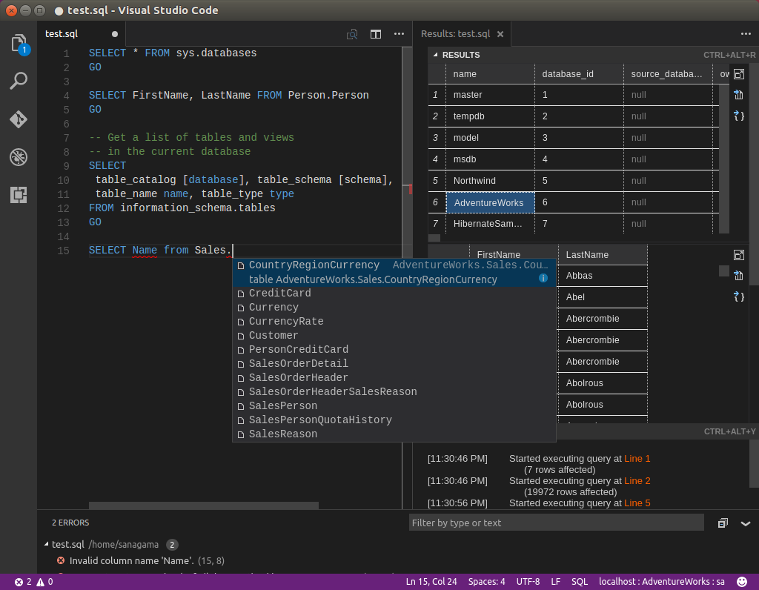
What’s coming in SQL Server vNext for Linux Tools and programmability
Windows-based SQL Server tools like SSMS, SSDT, Profiler work when connected to SQL Server on Linux
3rd party tools continue to work
Native command line tools: sqlcmd, bcp, sqlpackage
Visual Studio Code extension
New cross-platform DB admin GUI tool (planned)
All existing drivers and frameworks supported

Slide 15
Demo – Getting Started

Slide 16
What’s coming in SQL Server vNext for Linux Security
Goal: SQL Server on Linux supports the same enterprise-grade security capabilities that customers rely on with SQL Server on Windows. All built in.
Protect Data
Encryption at rest Transparent Data Encryption
Backup Encryption
Cell-Level Encryption
Encryption in transit Transport Layer Security (SSL/TLS)
Encryption in use (client) Always Encrypted
Protect Data
Encryption at rest Transparent Data Encryption
Backup Encryption
Cell-Level Encryption
Encryption in transit Transport Layer Security (SSL/TLS)*
Encryption in use (client) Always Encrypted
SQL
Control Access
Database access SQL Authentication
Active Directory Authentication
Granular Permissions
Application access Row-Level Security
Dynamic Data Masking
Control Access
Database access SQL Authentication
Active Directory Authentication*
Granular Permissions
Application access Row-Level Security
Dynamic Data Masking
Monitor Access
Tracking activities Fine-Grained Audit
*In progress
Notes:
So that’s High Availability and Disaster Recovery for SQL Server on Linux. Let’s look at another aspect of SQL Server that is also critically important for enterprises – security. Our goal is for SQL Server on Linux to support the same enterprise-grade security capabilities that customers rely on with SQL Server on Windows today.
[click]
We think about security for SQL Server in terms of layers. At the center, you have your data and how you protect the data itself, typically using encryption. SQL Server supports a variety of encryption features to help protect your data against different types of threats.
Transparent Data Encryption (TDE) encrypts your whole database at rest, without requiring any application changes. Backup Encryption encrypts your backup files, and Cell-Level Encryption gives you granular control over the encryption of individual cells of data.
To encrypt data in transit to and from the database, SQL Server supports the industry-standard TLS 1.2 protocol.
And finally, Always Encrypted enables you to encrypt sensitive data client-side, so that even privileged SQL Server administrators are unable to see it in plaintext.
[click]
The next layer is about controlling access to the data.
SQL Authentication allows users to authenticate via a username and password, while Active Directory Authentication allows users to authenticate using single sign-on through Active Directory and Kerberos. Granular permissions enable you to control access to individual tables or even columns of data.
Row-Level Security allows you to control read- and write-access to individual rows of data based on a customizable policy, and Dynamic Data Masking allows you to easily mask fields (such as account numbers) so that only part of the data can be seen.
[click]
The last layer is about monitoring who accesses the data.
SQL Server’s Fine-Grained Audit feature allows you to enforce a data audit policy and track which users are doing which actions.
[click]
So that’s where we’re going with security for SQL Server on Linux. Almost all of these features are already available for you to try in the CTP1 preview release, please try them out and share your feedback with us. Support for TLS is in progress and will become available in an upcoming build. Similarly, Active Directory Authentication is one of our most requested features and will become available in an upcoming build.

Slide 17
What’s coming in SQL Server vNext for Linux High availability and disaster recovery
Simple HADR
Standard HADR
Mission-Critical HADR
VM Failure
Failover Cluster
Availability Groups*
Resilience against guest & OS level failures
Planned & unplanned events
Minimum downtime for patching and upgrades
Minutes RTO
Instance level protection
Automatic failure detection & failover
Seconds to minutes RTO
Resilience against OS and SQL Server failures
Database level protection
Seconds RTO
No data loss
Recover from unplanned outage
No downtime for planned maintenance
Offload read/backup workload to active secondaries
Failover to geographically distributed secondary site
Backup/Restore
Basic Availability Groups*
Protection against accidental or malicious data corruption
DR protection
Minutes to hours RTO
AG with 2 replicas
Log Shipping*
Warm standbys for DR
*In progress
Notes:
Add diagram from Travis

Slide 18



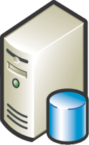

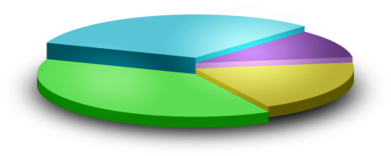



Solution
Problem
Mission critical application using SQL Server
HADR with Always On Availability Groups
DR
HA
WSFC
Linux Clustering
WSFC
Linux Clustering
Linux Clustering
WSFC
WSFC
Linux Clustering
Reports
Backups
Sync Log
Synchronization
Async Log Synchronization

Slide 19
Problem
Solution
High concurrent read volume application
Read Scale with Always On Availability Groups
S3
S1
P
S4
S2
Async Log Synchronization

Slide 20
Problems
Solution
Migrate application from SQL Server on Windows to Linux
ISV application certification on SQL Server on Linux
Minimum downtime with Always On Availability Groups
HA
WSFC
Linux Clustering
WSFC
HA
Linux Clustering
Sync Log
Synchronization
Async Log Synchronization

Slide 21
HADR Roadmap on Linux
 | CTP1 | By CTP2
High Availability
VM w/ durable storage | ● | ●
Failover Clustering | ● | ●
Always On Availability Groups | ○ In Progress | ●
Disaster Recovery
Backup & Restore | ● | ●
Log shipping | ○ In Progress | ●
Always On Availability Groups | ○ In Progress | ●
Migration
Always On Availability Groups | ○ In Progress | ●

Slide 22
Demo – Failover Clustering

Slide 23
Architecture

Slide 24
System Architecture
System Resource & Latency Sensitive Code Paths
Everything else
RDBMS
IS
AS
RS
SQL Platform Abstraction Layer
(SQLPAL)
Win32-like APIs
SQL OS API
SQL Platform Abstraction Layer
(SQLPAL)
SQL OS v2
Windows
Host Ext.
Linux Host Extension
Windows
Linux
Host Extension mapping to OS system calls
(IO, Memory, CPU scheduling)

Slide 25
Demo - Performance
Notes:
Install on RHEL Show nodejs app running in Docker compose VS code extension Open Shift Baby Benchcraft – performance
HA- AG??

Slide 26
SQL Server v.Next Timeline
CTP2 – production support for EAP
Monthly releases
3/2016
Announce and private preview
11/2016
Public Preview @ Connect()
Targeting
CY2017
GA
Notes:
In March 2016, we announced our intention to bring SQL Server to Linux, starting with a private preview effective immediately. In November, we launched our SQL Server v.Next public preview for both Windows and Linux. In the coming year, we will have updated previews approximately every month. Finally, targeting calendar year 2017, SQL Server will be generally available to purchase on Windows and Linux.

Slide 27
SQL Server Early Adoption Program
Customer Benefits
Microsoft Goals
Requirements
Direct access to engineering team via PM buddy and Yammer group
Visibility into roadmap
Provide feedback and input into design of new features and functionality
Full production support from Microsoft Support via special support channel
License amendment to allow running vNext in production prior to GA
Release to release upgrade support
Real world usage of SQL Server in production to verify quality, scale and performance
Discover bugs
Discover issues preventing customer adoption in production
Document customer evidence
NDA
Sign license agreement amendment
Complete pre-deployment questionnaire
Meet with Microsoft Support
ISVs, service providers and hosters with customers in EAP will also be added to EAP so they can participate there.
Notes:
Get rid of icons, go with simple 3 box format

Slide 28
Developing new applications on Linux Choose your path
Choose your development environment
Deploy your application
Upgrade to SQL Server v.Next
SQL Server 2016 on Windows
Deploy today and easily migrate to v.Next
Easily upgrade to SQL Server v.Next GA
Use simple backup and restore from Windows to Linux
OR
SQL Server v.Next CTP
Test your app today and go live close to GA with the Early Adoption Program
Easily upgrade to
SQL Server v.Next GA
Go-live
macOS
Notes:
When developing a new application on Linux, start your journey by developing locally on Linux, Windows, or macOS (via Docker). Then, deploy today on Windows via SQL Server 2016 or Linux with the public preview, and the adoption of engineering support for production with the SQL Server Adoption Program. Then, when SQL Server v.Next is available targeting mid-calendar year 2017, either do a simple backup and restore from SQL 2016 on Windows to SQL Server v.Next, or easily upgrade from the SQL Server on Linux public preview to the SQL Server v.Next GA.

Slide 29
Migrate to SQL Server v.Next Get free SQL Server licenses today when you migrate!*
Identify apps for migration
Use migration tools and partners
Deploy to production
Run SQL Server v.Next
SQL Server 2016 on Windows
Deploy today and easily migrate to v.Next
Easily upgrade to SQL Server v.Next GA
Use simple backup and restore from Windows to Linux
Oracle
SQL Server Migration Assistant
AND
OR
Sybase
SQL Server v.Next CTP
Test your app today and go live close to GA with the Early Adoption Program
Easily upgrade to SQL Server v.Next GA
Go-live
Global partner ecosystem
DB2
*Software Assurance subscription required. Some restrictions may apply. Limited time offer—free training and subsidized deployment services available until December 31, 2016. https://www.microsoft.com/en-us/sql-server/sql-license-migration
Notes:
SQL Server leads the industry on security, performance, and price. And we want to prove to you that there is no equal. Move your Oracle databases to SQL Server and receive the necessary licenses of SQL Server—free with software assurance. Take advantage of this offer and get the one data solution that has everything you need built in.
When you migrate, take advantage of our SQL Server Migration Assistant tool, and leverage our vast global partner ecosystem.

Slide 30
Download the bits http://sqlserveronlinux.com
Apply to join the SQL Early Adoption Program
https://aka.ms/eapsignup
Notes:
Get started today with the SQL Server v.Next public preview by going to www.sqlserveronlinux.com, where you’ll find instructions for Red Hat Enterprise Linux, Ubuntu Linux, SQL Server on Linux-based Azure Virtual Machines, and Docker. Coming soon, the preview will include SUSE Linux as well.
SQL EAP (pronounced “SQL Leap”) is a Microsoft program to help customers and partners adopt the next version of SQL Server.

Slide 31
Additional Resources
Code Projects shown in demos today:
https://github.com/twright-msft/dotnet-mssql-connect
https://github.com/twright-msft/example-voting-app
https://github.com/twright-msft/columnstore-demo
Benchmarking tool – coming soon!
Get started programming with SQL Server
http://aka.ms/sqldev
Training videos and certifications
http://aka.ms/nicconf
Join us in the community
Reddit.com/r/sqlserver
Stack Overflow – tag: sql-server
Twitter - @SQLServer, #SQLServer
Connect.microsoft.com for feature requests and bug reports

